Slide 1
Inimese 4-nda kromosoomi q-õla kaugeima geeni koopiaarvu varieeruvus.
Ajakirjaklubi bioinformaatikas
Tarmo Puurand
12.01.2017

Slide 2
Räägin:
Kuidas chr4 q õla telomeerieelne piirkond üles ehitatud on?
Mis teeb tema eriliseks?
Mis haigusega ja kuidas seotud on?
Tõendusmaterjali kirjeldus.
Pacific bioscience lugemid
K-mer sagedused annavad indikatiivse vihje

Slide 3
GRCh38 vs. GRCh37 chr4 q-õla telomeerne ots

Slide 4
GRCh38 vs. GRCh37 chr10 q-õla telomeerne ots

Slide 10
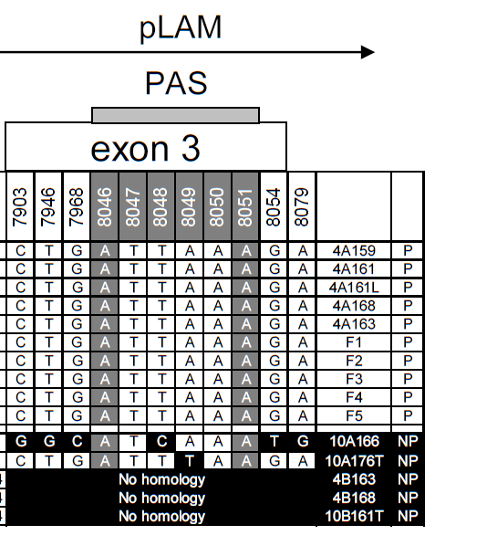

Slide 11
DUX4 expression analysis after transfection of the distal D4Z4 unit and flanking pLAM sequence into C2C12 mouse myoblast cells. (A) Northern blot analysis of C2C12 mouse myoblast cells transfected with genomic D4Z4 constructs [see (B)] derived from permissive (lanes 1 to 4) or nonpermissive (lanes 6, 7, and 9) chromosomes or constructs in which the poly(A) signals from nonpermissive chromosomes are replaced
by those from permissive chromosomes (4PAS, lanes 8 and 10) and vice versa (10mPAS, lane 5). Only constructs with canonical poly(A) signals show a DUX4 transcript. Cotransfected EGFP gene was used as a
control.

Slide 12
Schematic of the transfected sequence, including the distal D4Z4 unit and flanking pLAM sequence. The DUX4 gene and the poly(A) signal are part of the transfected sequence. The main spliced DUX4 transcript and its open reading frame (ORF) are indicated. The primers used to quantify polyadenylation efficiency are indicated. The boxed area shows the design of the assay to infer the polyadenylation efficiency of the DUX4 poly(A) signal. The forward primer straddles exons 2 and 3 and is therefore specific for the spliced DUX4 transcript. The primer set proximal to the poly(A) signal (PAS) and a primer set using the same forward primer but a reverse primer distal to the poly(A) signal (DAS) are indicated, as well as the expected PAS/DAS ratios.

Slide 13
Bar diagram with the observed PAS/DAS ratios of permissive chromosomes (lanes 3 and 4), nonpermissive chromosomes (lanes 6, 7, and 9), and permissive chromosomes in which the poly(A) signal is replaced for a sequence derived from a nonpermissive chromosome (10mPAS, lane 5) or vice versa (4PAS, lanes 8 and 10), or of pathogenic chromosomes derived from families F1 and F3 (lanes 1 and 2). Lane 11 is a negative control. ND, not detected. Error bars represent values of quadruple experiments with standard errors of the mean.

Slide 14
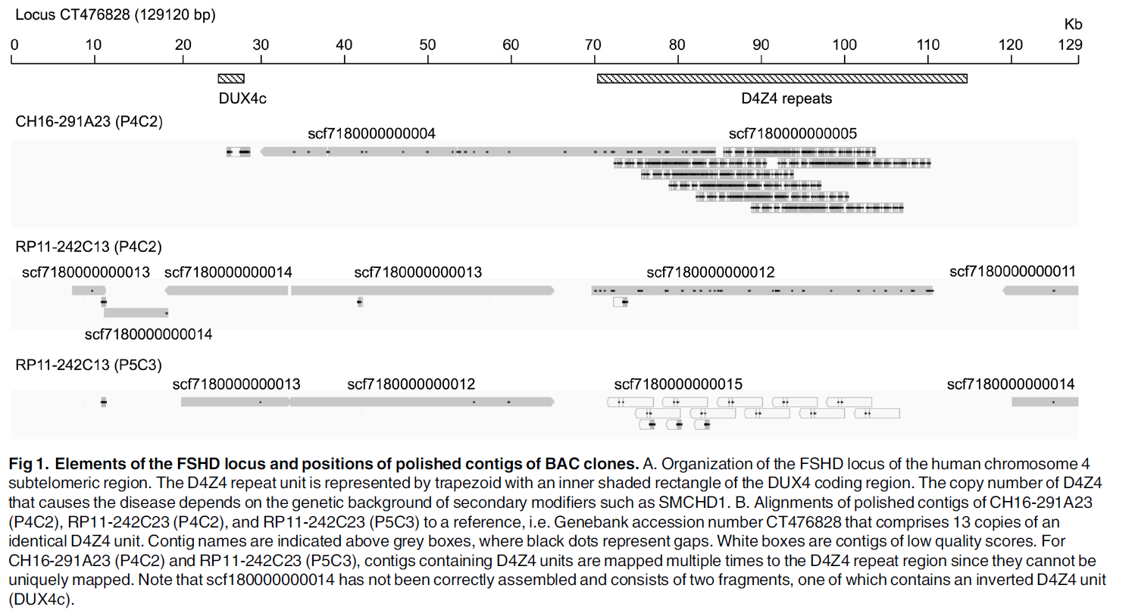
Pacific Bioscience järjestused
Single molecule real time (SMRT) sequencing up to 18 kB

Slide 15
Conservation of transcription factor binding motifs in the D4Z4 array. A total of D4Z4 sequences obtained by either anchored multiple sequence alignment (P5C3_ and P4C2_ followed by positions in the array) or resequencing using longest P5C3 subreads containing D4Z4 and 5' or 3' flanking unique sequences (HGAP_ followed by positions in the array) were aligned to each other to assess sequence variations. Depicted are regions upstream of ATG translation start site that contain known motifs such as PRE, YY1, GC box, and TACAA box.

Slide 17
Mida meelde jätta
Aeg-ajalt rekombineeruvad väga sarnased chr4 ja chr10 q-õlgade päris viimased otsad omavahel, kus asuvad DUX4 geenide tandeemsed kordused.
FSHD avaldub siis, kui DUX4 geene on alla 10, ning kui chr4 telomeerne ots kuulub klassi A, mille haiguspõhjuslik erinevus tervetest on polyA signaaljärjestuse esinemine exon 3-s. Metülatsioonimuster on ka oluline.
k-mer metoodikaga on lihtne määrata nii DUX4 geeni ligilähedast koopiaarvu kui ka polyA signaaljärjestuse esinemist.

Slide 18
Artiklid:
Worldwide population analysis of the 4q and 10q subtelomeres identifies only four discrete interchromosomal sequence transfers in human evolution.
Lemmers RJ, van der Vliet PJ, van der Gaag KJ, Zuniga S, Frants RR, de Knijff P, van der Maarel SM.
Am J Hum Genet. 2010 Mar 12;86(3):364-77. doi: 10.1016/j.ajhg.2010.01.035.
Genomic analysis of human chromosome 10q and 4q telomeres suggests a common origin.
van Geel M, Dickson MC, Beck AF, Bolland DJ, Frants RR, van der Maarel SM, de Jong PJ, Hewitt JE.
Genomics. 2002 Feb;79(2):210-7.
A unifying genetic model for facioscapulohumeral muscular dystrophy.
Lemmers RJ, van der Vliet PJ, Klooster R, Sacconi S, Camaño P, Dauwerse JG, Snider L, Straasheijm KR, van Ommen GJ, Padberg GW, Miller DG, Tapscott SJ, Tawil R, Frants RR, van der Maarel SM.
Science. 2010 Sep 24;329(5999):1650-3. doi: 10.1126/science.1189044.
Filling in the Gap of Human Chromosome 4: Single Molecule Real Time Sequencing of Macrosatellite Repeats in the Facioscapulohumeral Muscular Dystrophy Locus.
Morioka MS, Kitazume M, Osaki K, Wood J, Tanaka Y.
PLoS One. 2016 Mar 22;11(3):e0151963. doi: 10.1371/journal.pone.0151963.

